Slide 1
Ontology Descent planning meeting

Slide 2
Development methodology
Which interactivity flavor?
Shiny vs flexdashboard
Lets try to do this using Agile philosophy:
Responsiveness vs sticking to the plan
Our communication vs proccess and tools
Working software vs comprehensive documentation
Set (soft) deadlines to ourselves for completing the task
Person doing the task decides their own timeline

Slide 3
Overall aim
Launch a web wizard to cluster hierarchichal gene ontologies or pathways
Include a local R package (?)
Have a Bioarxiv manuscript with the web launch (and publish it eventually)
Doable within 3 months?
3 months @ 4h a week x 3.5 ppl = ~200 h of programing

Slide 4
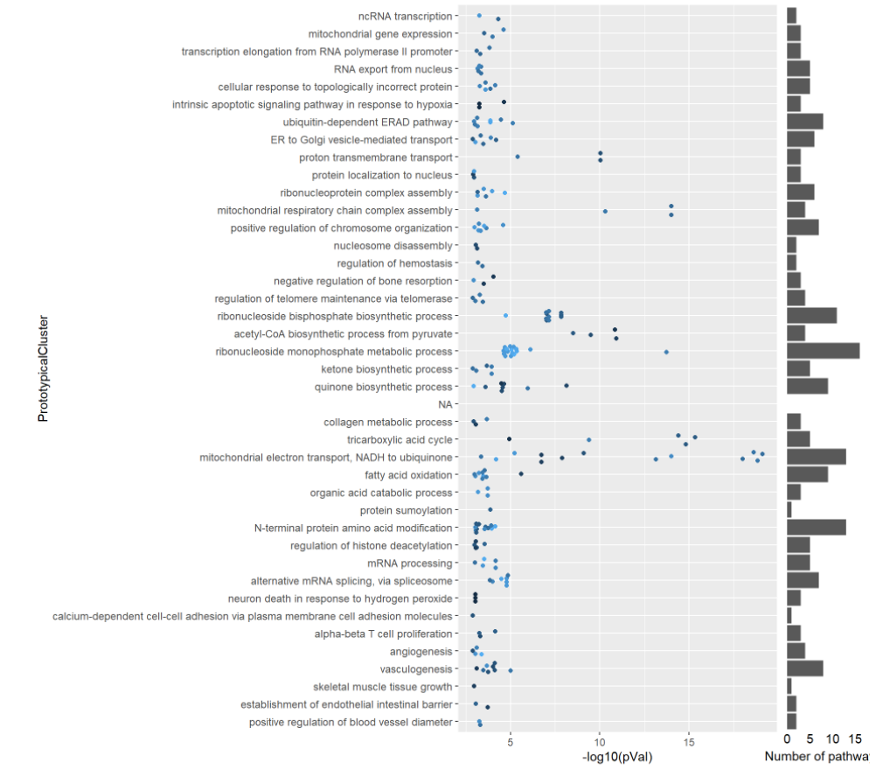
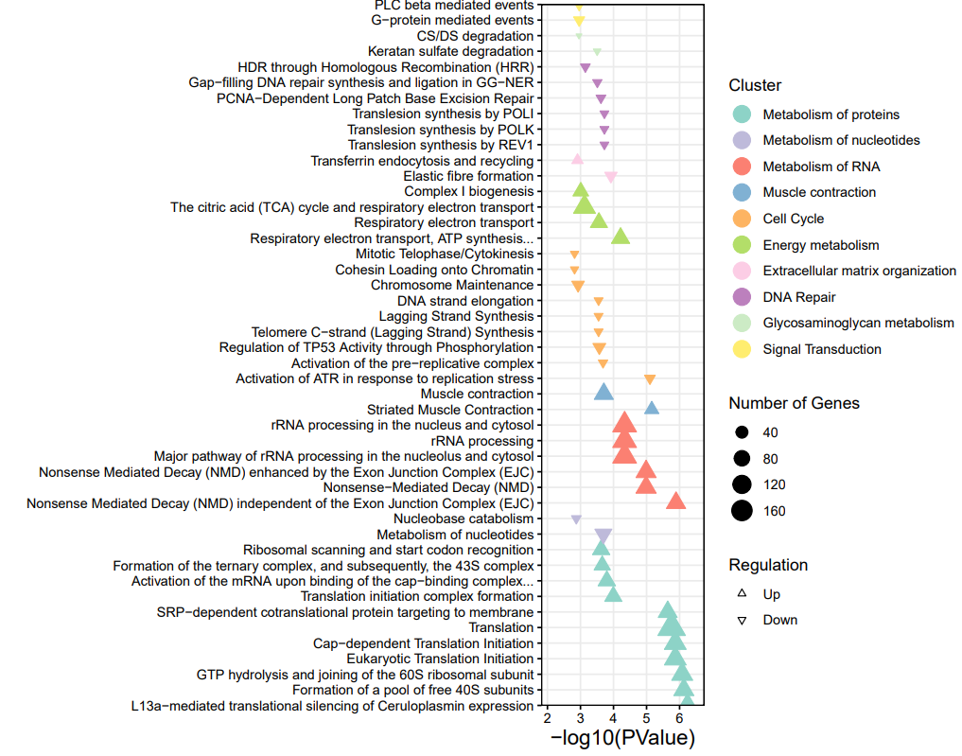
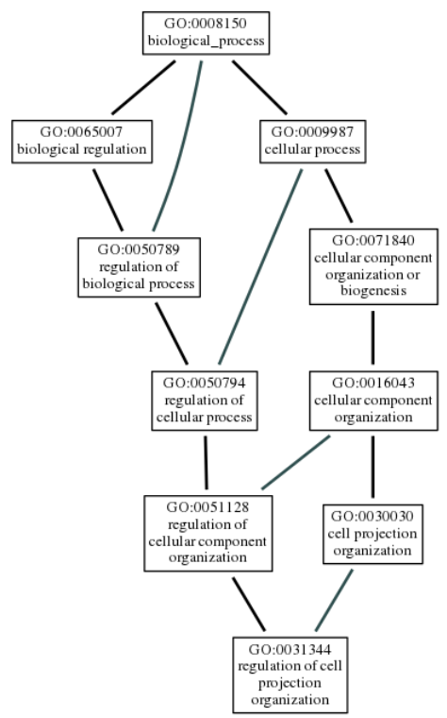
Rough draft of target

Slide 5
Rough draft of target
2-3 tabs:
Tab 1 – data input and clustering
Tab 2 – double check and
fine-tune cluster
Tab 3 – clustering & visualizing
Point shape
Point size
Y axis
X axis
Buttons to set options
Select number clusters
Terms
Enrichment
P-values
P-values
Fine tune clusters by
draging
Buttons plot options

